Slide 1

Android UI & Layout
NISHCHIT pANDEY

Slide 2
Android UI designing can be done either in XML or programmatically in application. But the Android UI designer mostly prefer XML for defining UI because it separate the presentation from the code and makes easier to visualize, manage, edit and debug the App.

Slide 3
Android Studio And SDK
Android Studio And SDK: Android Studio is the official IDE for developing Android App created by Google.
It has a very simple layout editor which support drag and drop for designing UI where one can drag layout, widgets, text fields etc.
It also has the properties option where one can easily fill attribute like color, text etc to give attractive and pretty look to UI.
The Studio also has Text option where one can see the XML code of the UI and edit it.

Slide 4
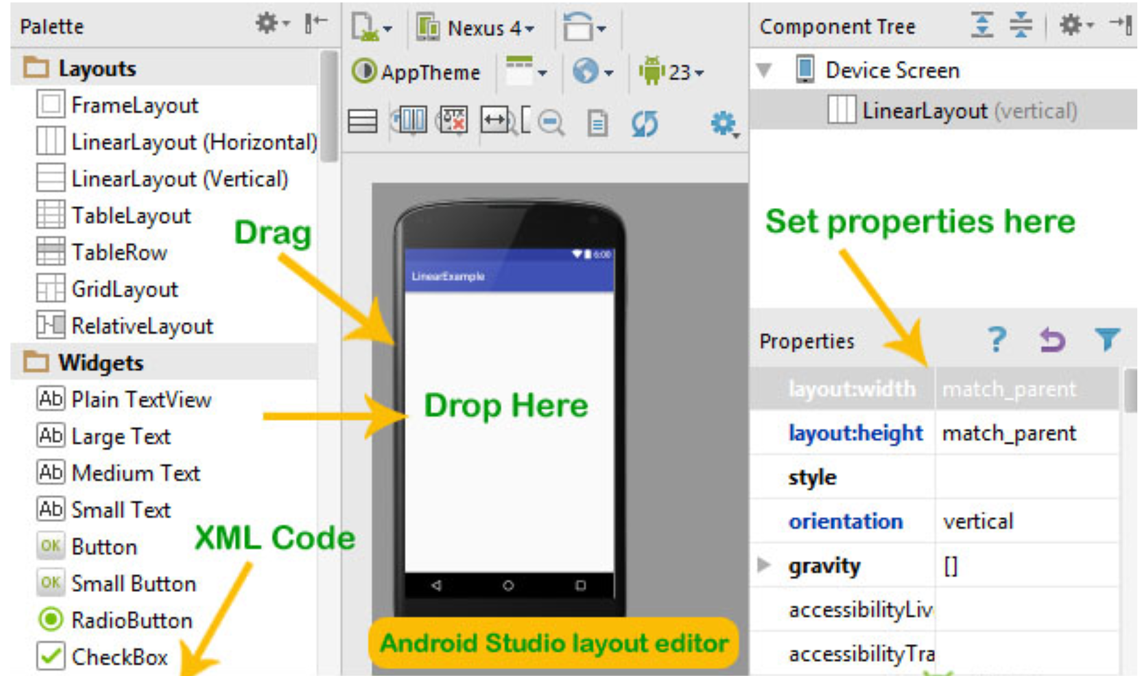

Slide 5
XML ( Extensible Markup Language) In Android
XML is a markup language much like HTML used to describe data.
XML tags are not predefined in XML. We must define our own Tags. Xml as itself is well readable both by human and machine.
In Android we use xml for designing our layouts because xml is lightweight language so it doesn’t make our layout heavy.

Slide 6
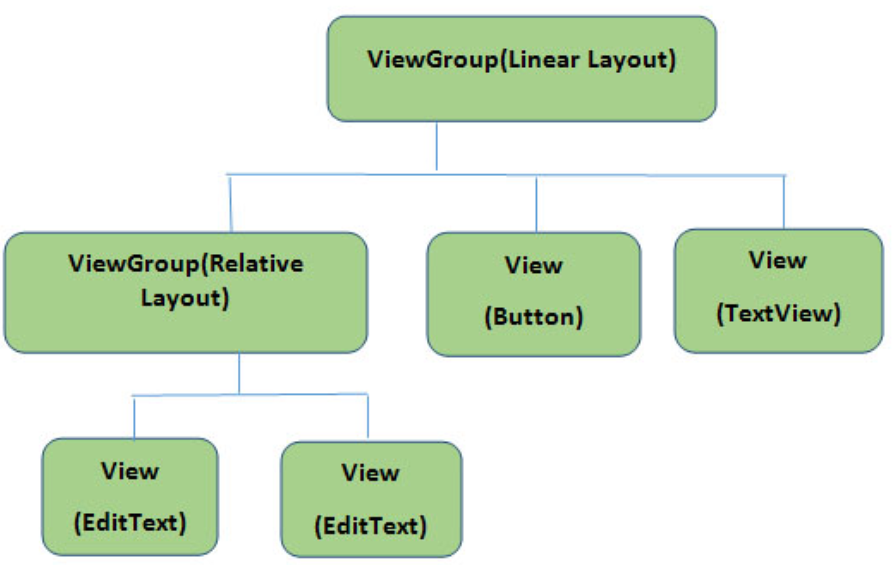
Basics Of User Interface:
The whole concept of Android User Interface is defined using the hierarchy of View and ViewGroup objects.
One ViewGroup can have another ViewGroup as an child element as shown in the figure given below:
Here the Diagram below ViewGroup (Linear Layout) contains one ViewGroup (i.e. Relative Layout)and two View(Button and TextView). Further two more View (i.e. 2 EditText ) are nested inside Relative Layout ViewGroup. It is important to note that one layout can be nested in another layout.

Slide 7
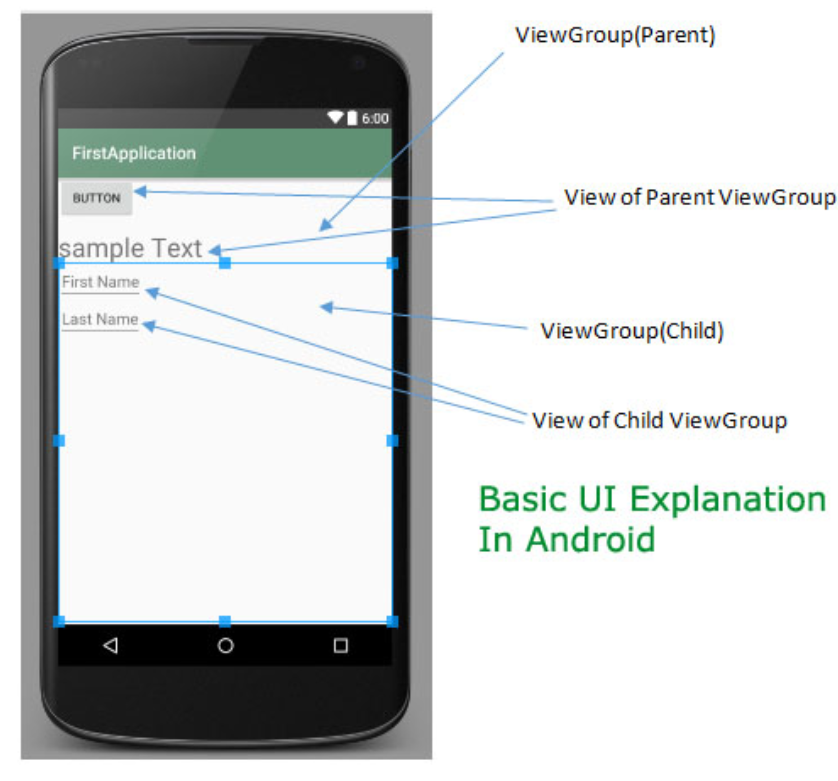
Every Android application screen has some components like button, Text or images. These are contained inside the ViewGroup. Layouts are the best examples for ViewGroups. The different types of layout in android are Linear Layout, Relative Layout, Absolute Layout, Table Layout and Frame Layout.

Slide 8
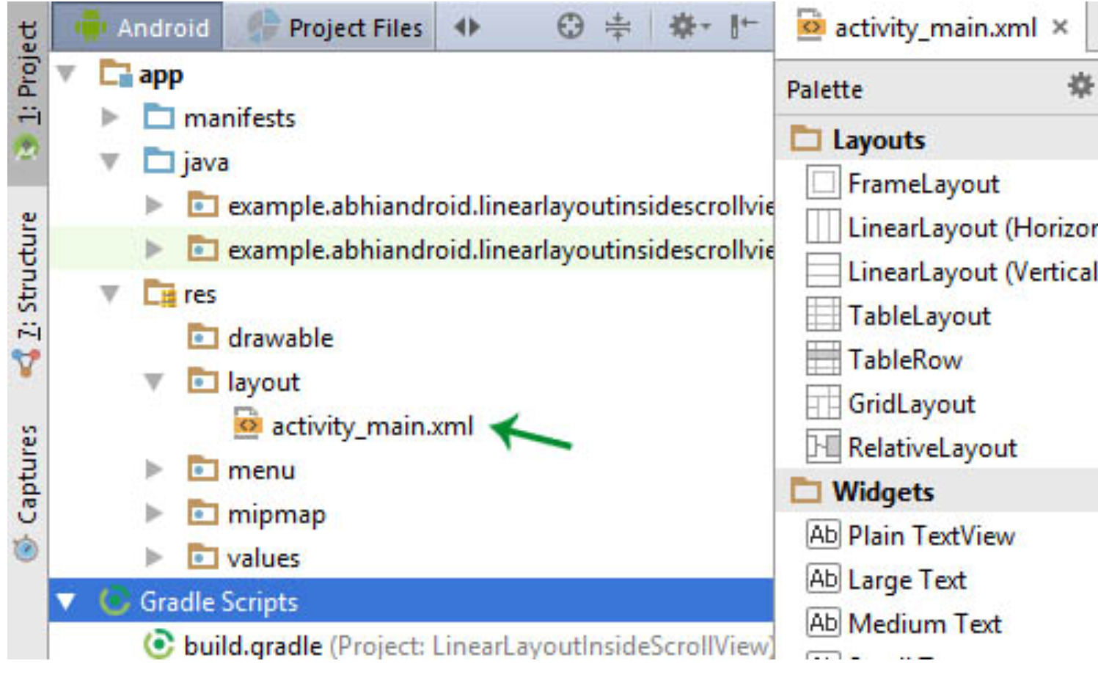
Different XML Files Used in Android:
Layout XML Files :
Layout xml files are used to define the actual UI(User interface) of our application. It holds all the elements(views) or the tools that we want to use in our application. Like the TextView’s, Button’s and other UI elements.

Slide 9
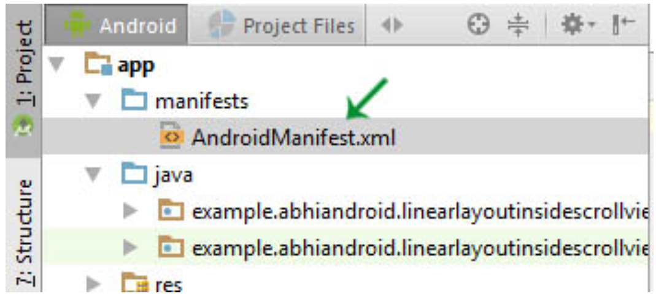
Manifest xml File(Mainfest.xml):
This xml is used to define all the components of our application. It includes the names of our application packages, our Activities, receivers, services and the permissions that our application needs. For Example – Suppose we need to use internet in our app then we need to define Internet permission in this file.

Slide 10
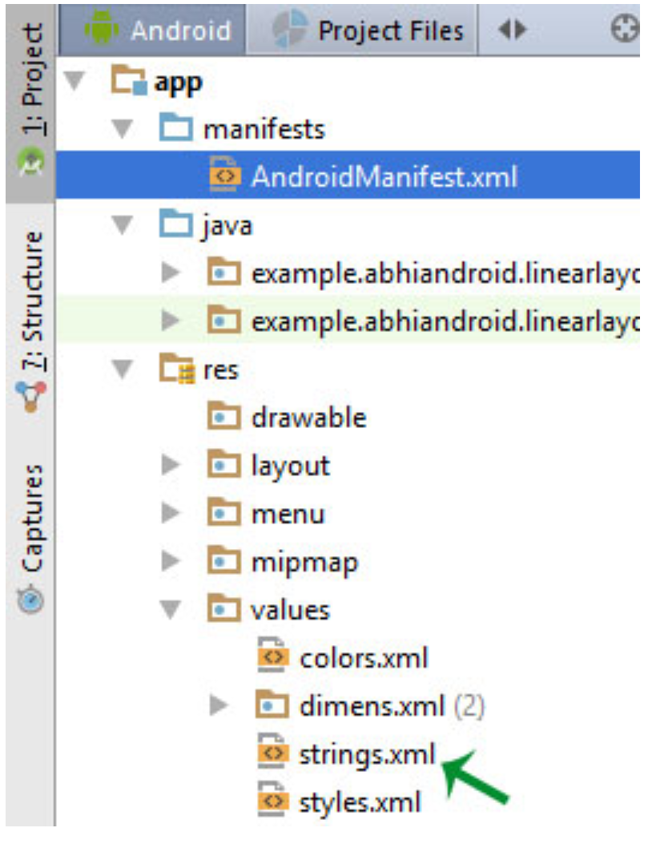
Strings xml File(strings.xml):
This xml file is used to replace the Hard-coded strings with a single string. We define all the strings in this xml file and then access them in our app(Activity or in Layout XML files) from this file. This file enhance the reusability of the code.

Slide 11
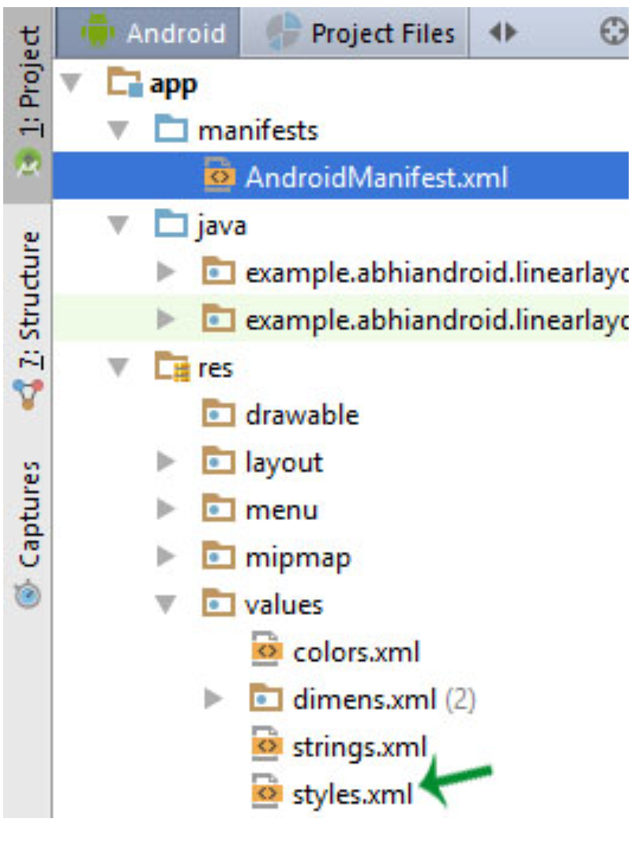
Styles xml File(styles.xml):
This xml is used to define different styles and looks for the UI(User Interface) of application. We define our custom themes and styles in this file.

Slide 12
Drawable xml Files:
These are those xml files that are used to provide various graphics to the elements or views of application. When we need to create a custom UI we use drawable xml files. Suppose if we need to define a gradient color in the background of Button or any custom shape for a view then we create a Drawable xml file and set it in the background of View.

Slide 13
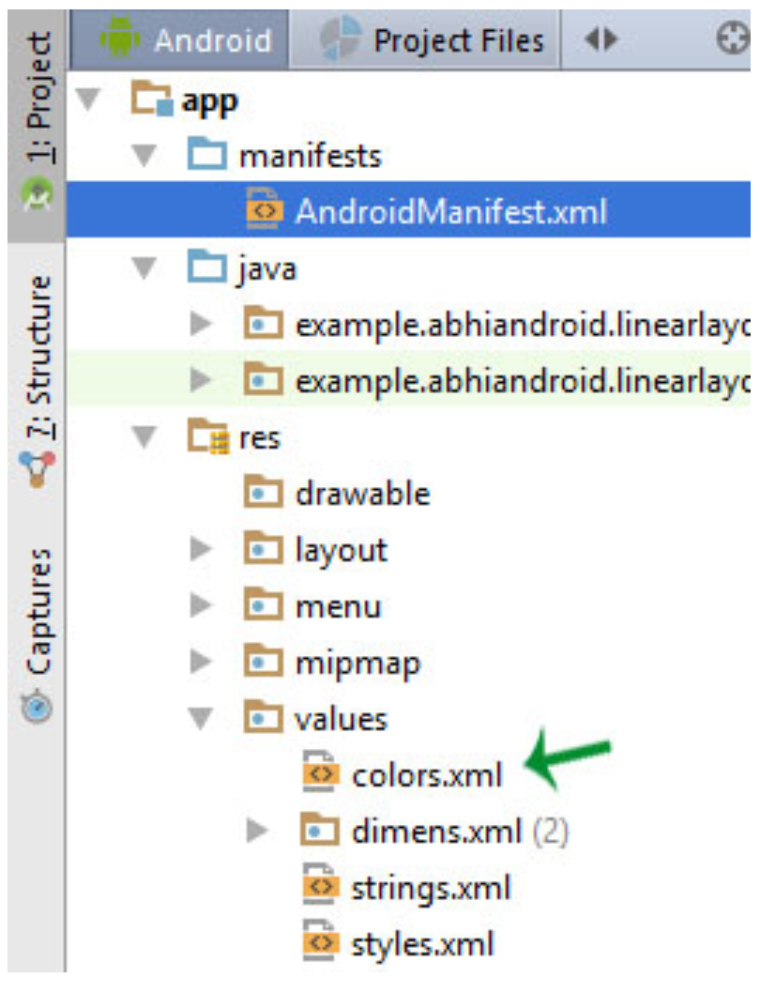
Color xml File (colors.xml):
This file is used to define the color codes that we used in our app. We simply define the color’s in this file and used them in our app from this file.

Slide 14
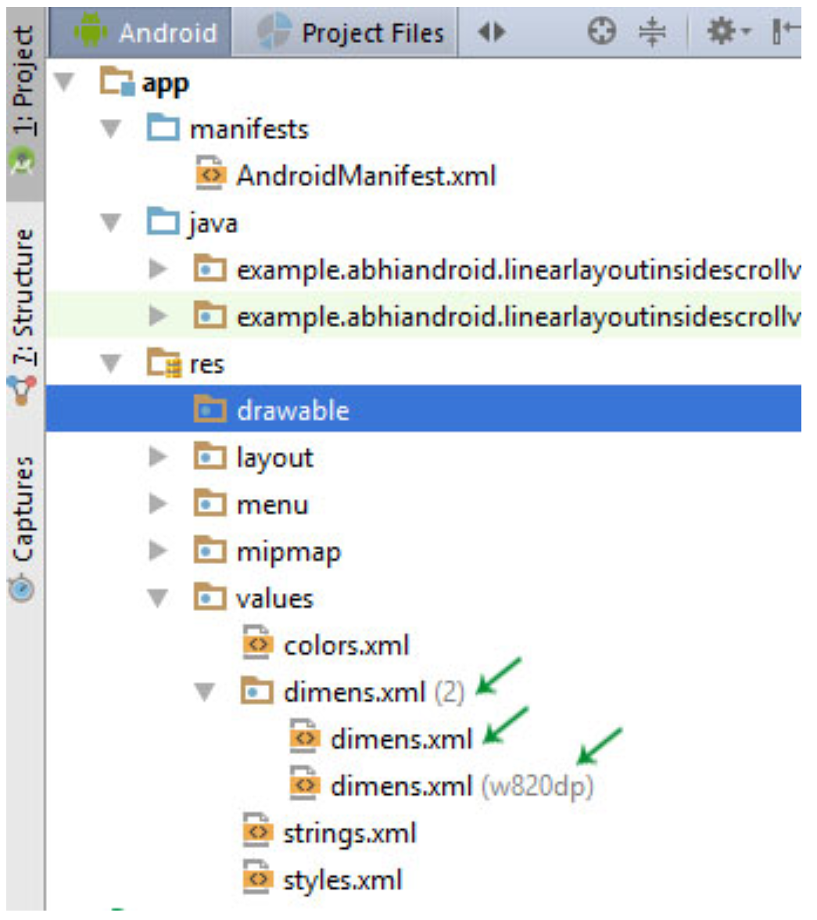
Dimension xml File(dimens.xml):
This xml file is used to define the dimensions of the View’s. Suppose we need a Button with 50dp(density pixel) height then we define the value 50dp in dimens.xml file and then use it in our app from this file.

Slide 15
Layout in Android:
Layout are used to define the actual UI(User interface) of our application. It holds all the elements (i.e. views) or the tools that we want to use in our application. For example, TextView, Button and other UI elements.
Types Of Layout And Few Important ViewGroup In Android
1) Constraint Layout
2) Linear Layout
3) Relative Layout
4) Table Layout
5) Frame Layout
6) Absolute Layout
7) ListView
8) GridView

Slide 16
Constraint Layout
Constraint Layout is a ViewGroup (i.e. a view that holds other views) which allows you to create large and complex layouts with a flat view hierarchy, and also allows you to position and size widgets in a very flexible way. It was created to help reduce the nesting of views and also improve the performance of layout files.
ConstraintLayout is very similar to RelativeLayout in such a way because, views are laid out according to relationships between sibling views and the parent layout yet it’s a lot more flexible and works better with the Layout Editor of the Android Studio’s. It was released at Google I/O 2016. Since it came into existence (i.e. as at Android studio 2.3), it has become a wildly used viewgroup and supports Android 2.3 or higher.

Slide 17
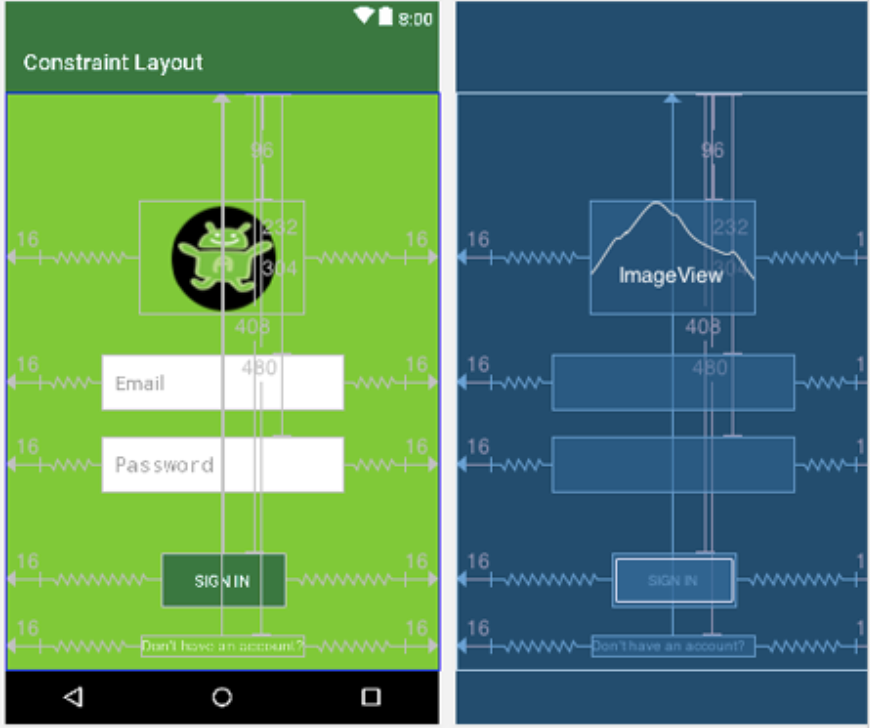
Advantages Of Constraint Layout Over Other Layouts
One great advantage of the Constraint layout is that you can perform animations on your Constraint Layout views with very little code.
You can build your complete layout with simple drag-and-drop on the Android Studio design editor.
You can control what happens to a group of widgets through a single line of code.
Constraint Layout improve performance over other layout

Slide 18
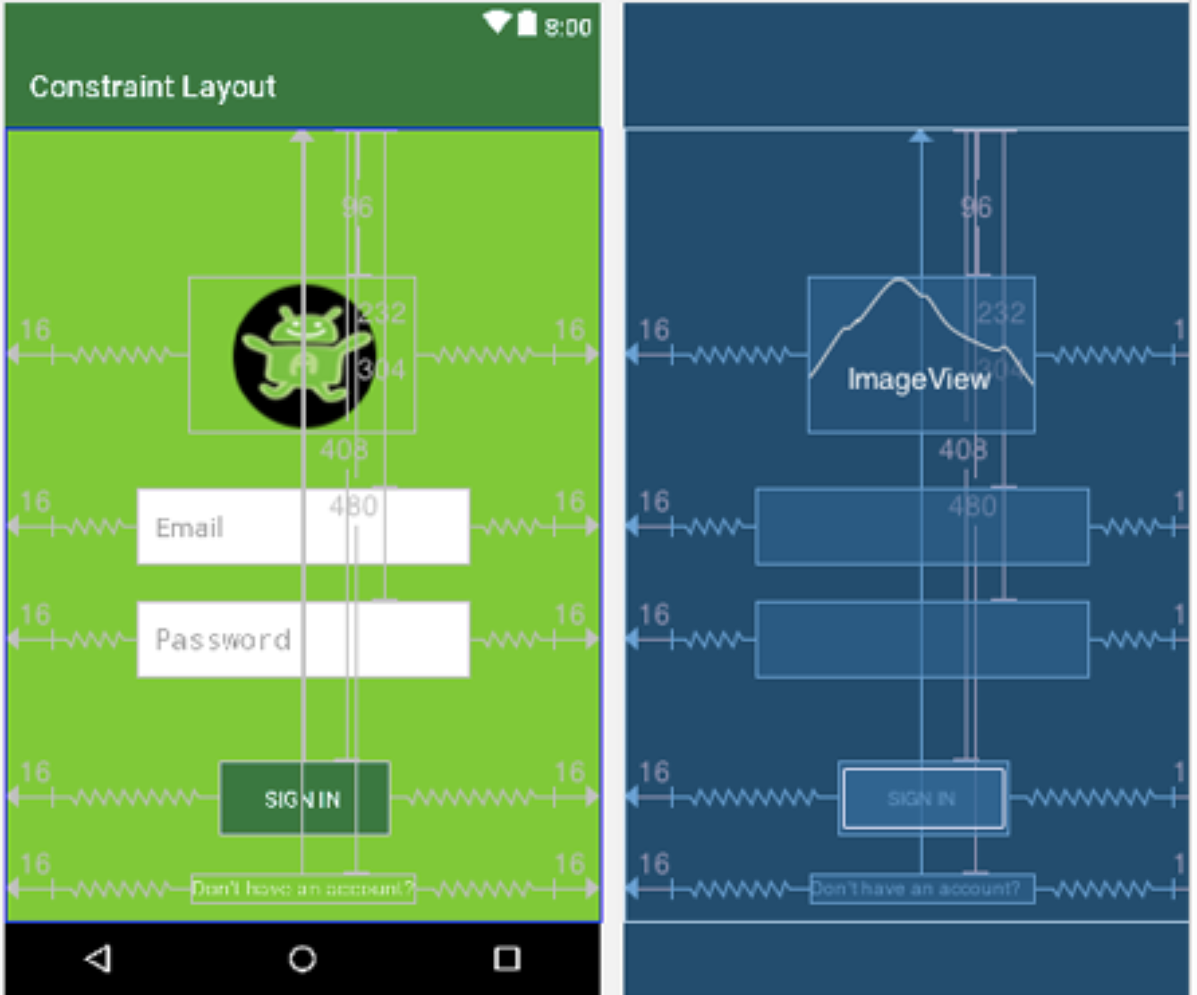
Constraint Layout Example in Android Studio:
We design the simple Login screen in Constraint Layout. We used Image View, Edit Text, Button and Text View for designing the below layout.
Step 1: Create a new project Constraint Layout and activity Main Activity. Here we will create a Constraint Layout
Step 2: Add other views(image view, edit text, button and text view) by adding both horizontal and vertical constraints to them.

Slide 19
Important Points About Constraint Layout:
To use Constraint Layout,
Your Android Studio version must be 2.3 or higher.
You must first include the Constraint Layout’s support library.
You must have at least one vertical and one horizontal constraints.
In conclusion, Constraint Layout is a faster, better and much more efficient choice to designing large and aesthetic layouts in your Android UI.

Slide 20
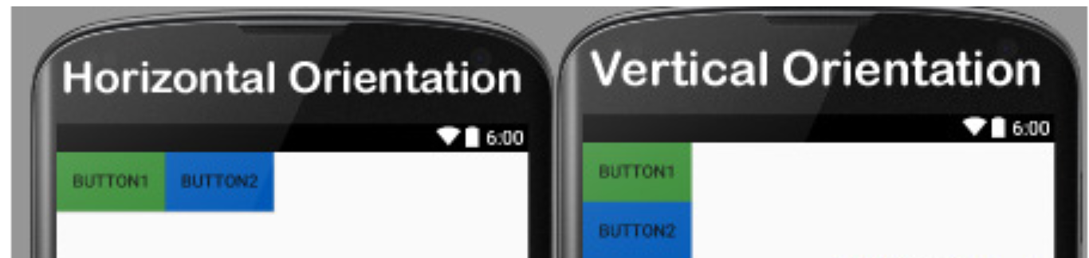
Linear Layout
Linear layout is a simple layout used in android for layout designing. In the Linear layout all the elements are displayed in linear fashion means all the child /elements of a linear layout are displayed according to its orientation. The value for orientation property can be either horizontal or vertical.

Slide 21
Relative Layout
The Relative Layout is very flexible layout used in android for custom layout designing.
It gives us the flexibility to position our component/view based on the relative or sibling component’s position.
Just because it allows us to position the component anywhere we want so it is considered as most flexible layout.
For the same reason Relative layout is the most used layout after the Linear Layout in Android. It allow its child view to position relative to each other or relative to the container or another container.

Slide 22
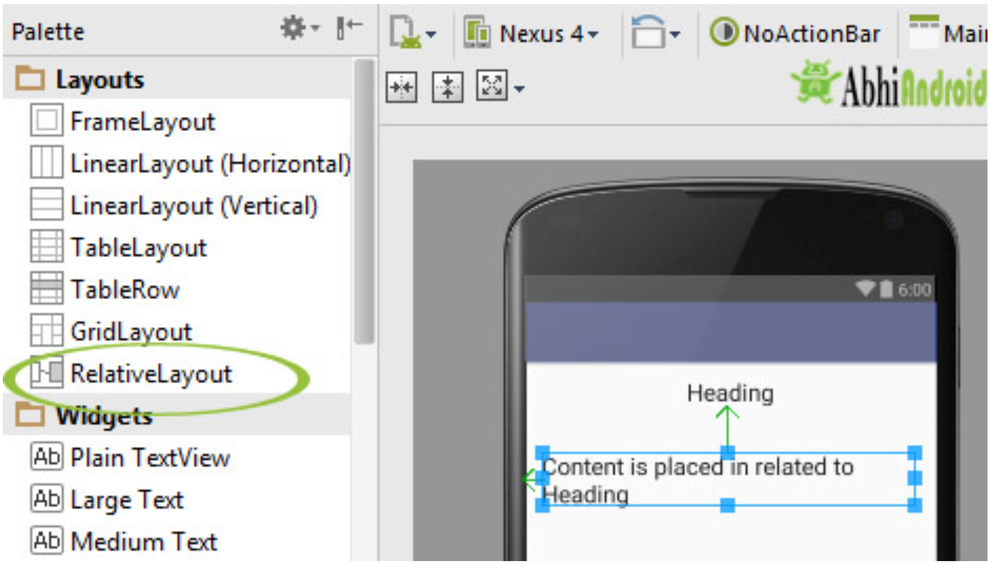
Relative Layout
In Relative Layout, you can use “above, below, left and right” to arrange the component’s position in relation to other component. For example, in the image you can see content is placed in related to Heading.
Even though Android has drag and drop system to put one component in related to other inside relative layout. But actually in the background lots of XML properties are working which does this task. So Android developer can design UI either using drag & drop or using XML code. Professional developer uses both for designing UI.

Slide 23
Relative Layout
Every element of relative layout arranges itself to the other element or a parent element.
It is helpful while adding views one next to other etc
In a relative layout you can give each child a Layout Property that specifies exactly where it should go in relative to the parent or relative to other children.
Views can be layered on top of each other.

Slide 24
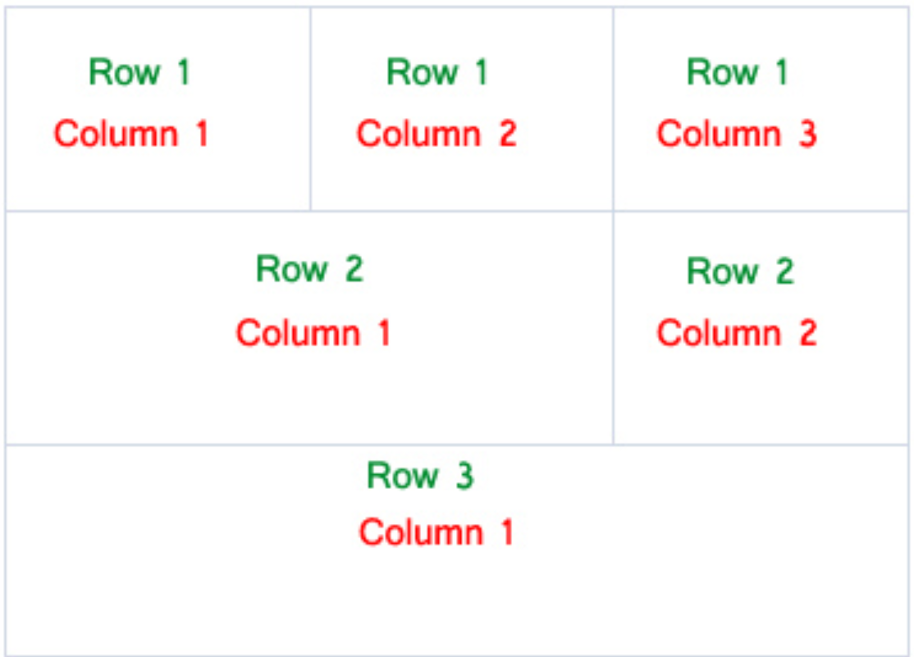
Table Layout
In Android, Table Layout is used to arrange the group of views into rows and columns. Table Layout containers do not display a border line for their columns, rows or cells. A Table will have as many columns as the row with the most cells.
A table can also leave the cells empty but cells can’t span the columns as they can in HTML(Hypertext markup language).

Slide 25
Important Points About Table Layout In Android
For building a row in a table we will use the <TableRow> element. Table row objects are the child views of a table layout.
Each row of the table has zero or more cells and each cell can hold only one view object like ImageView, TextView or any other view.
Total width of a table is defined by its parent container
Column can be both stretchable and shrinkable. If shrinkable then the width of column can be shrunk to fit the table into its parent object and if stretchable then it can expand in width to fit any extra space available.
Important Note: We cannot specify the width of the children’s of the Table layout. Here, width always match parent width. However, the height attribute can be defined by a child; default value of height attribute is wrap content.

Slide 26
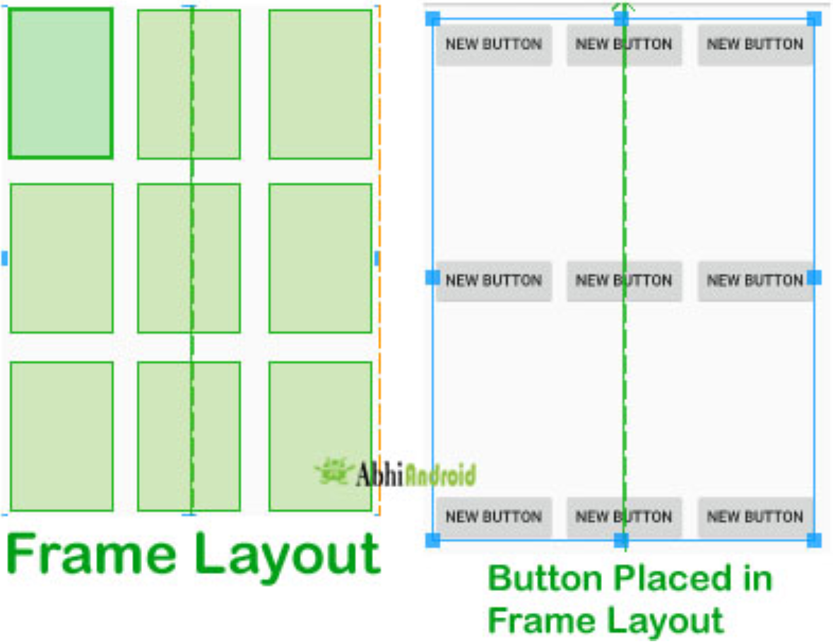
Frame Layout
Frame Layout is one of the simplest layout to organize view controls. They are designed to block an area on the screen. Frame Layout should be used to hold child view, because it can be difficult to display single views at a specific area on the screen without overlapping each other.
We can add multiple children to a Frame Layout and control their position by assigning gravity to each child, using the android: layout_gravity attribute.

Slide 27
Absolute Layout
In Android, an Absolute Layout is a layout used to design the custom layouts. In this layout you can specify the exact location of its children by using x and y coordinates.
Absolute layout are harder to maintain for different mobile screen sizes than other types of layouts because we set the exact location of a child view or called component. The positioning is based on x(top) and y(left) coordinates and that positioning is not as useful in world of various screen resolutions(sizes) and aspect ratios.
Try opening the same layout in different size Emulator and you will see it doesn’t fit in different size device. That’s why Android has depreciated the use of Absolute Layout.

Slide 28
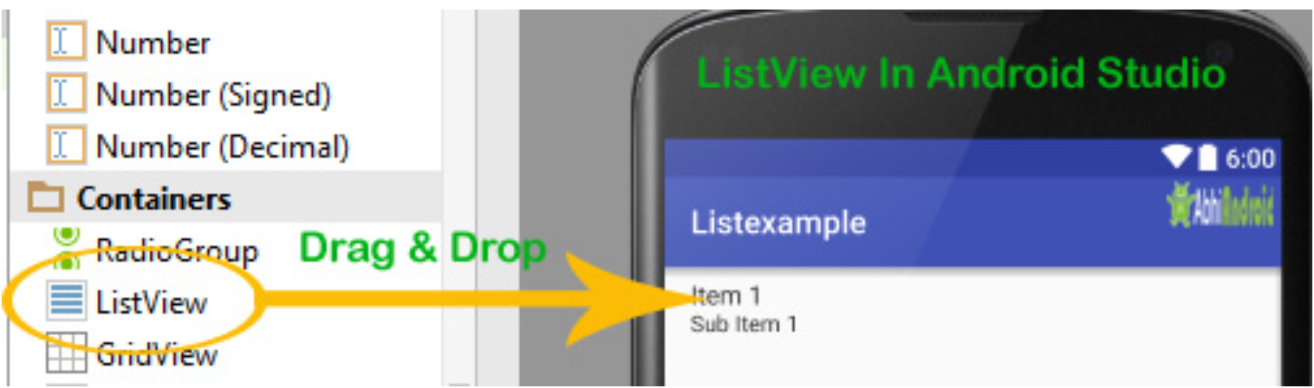
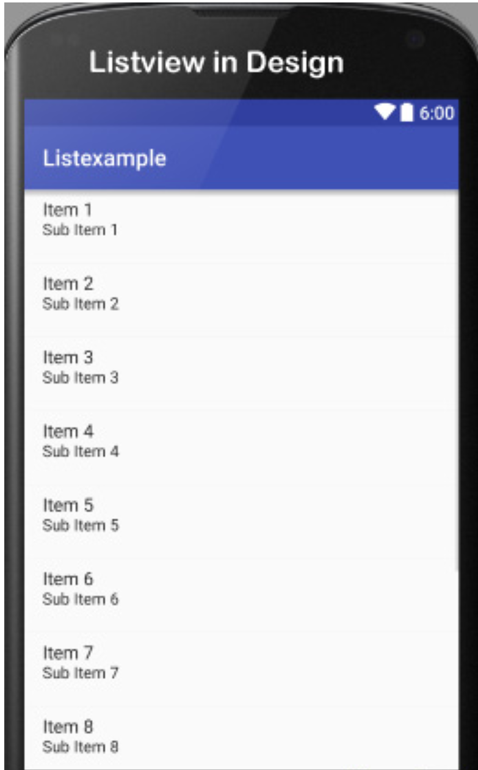
List view
List of scrollable items can be displayed in Android using List View.
It helps you to displaying the data in the form of a scrollable list.
List View is default scrollable so we do not need to use scroll View or anything else with List View.
To fill the data in a List View we simply use adapters.
List items are automatically inserted to a list using an Adapters that pulls the content from a source such as an array list, array or database.

Slide 29
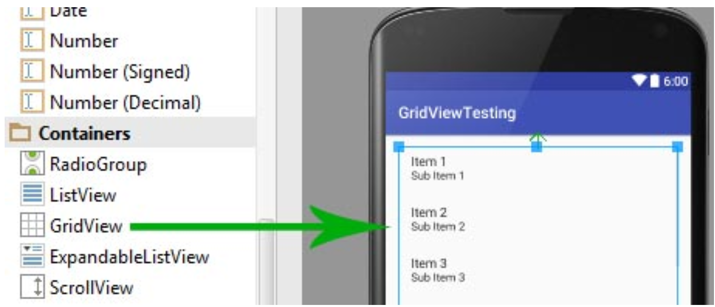
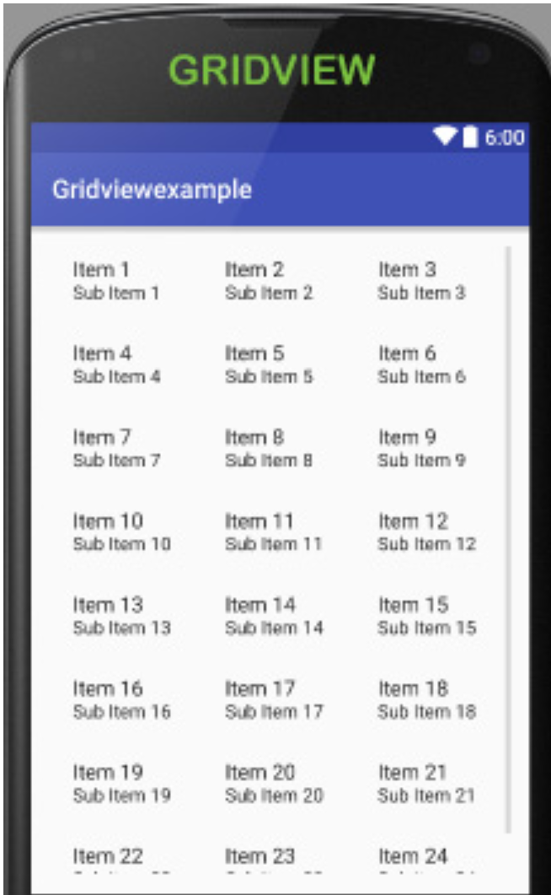
Grid View
In android Grid View is a view group that display items in two dimensional scrolling grid (rows and columns).
Grid View is default scrollable so we don’t need to use Scroll View or anything else with Grid View.
Grid View is widely used in android applications. An example of Grid View is your default Gallery.
To fill the data in a Grid View we simply use adapter and grid items are automatically inserted to a Grid View using an Adapter

Slide 30
Thank you !!!

